Slide 1


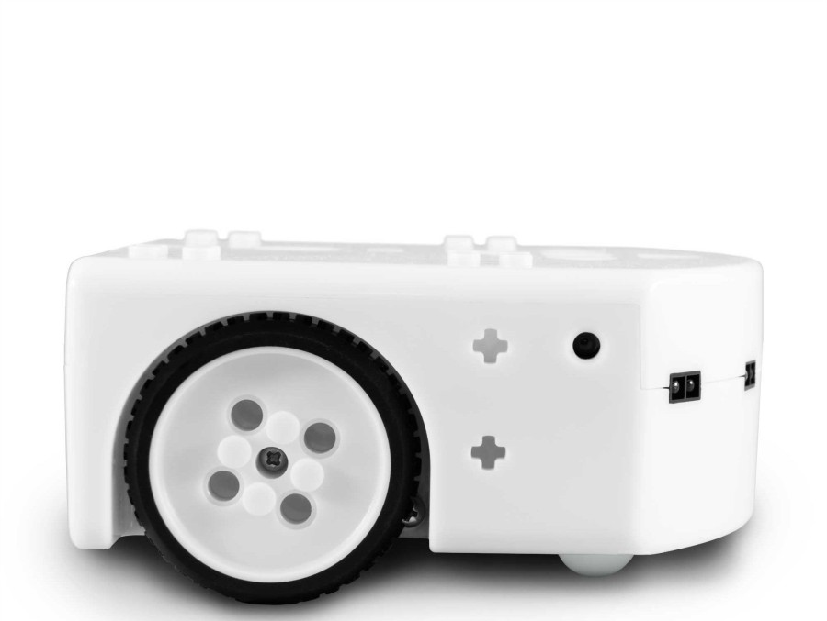
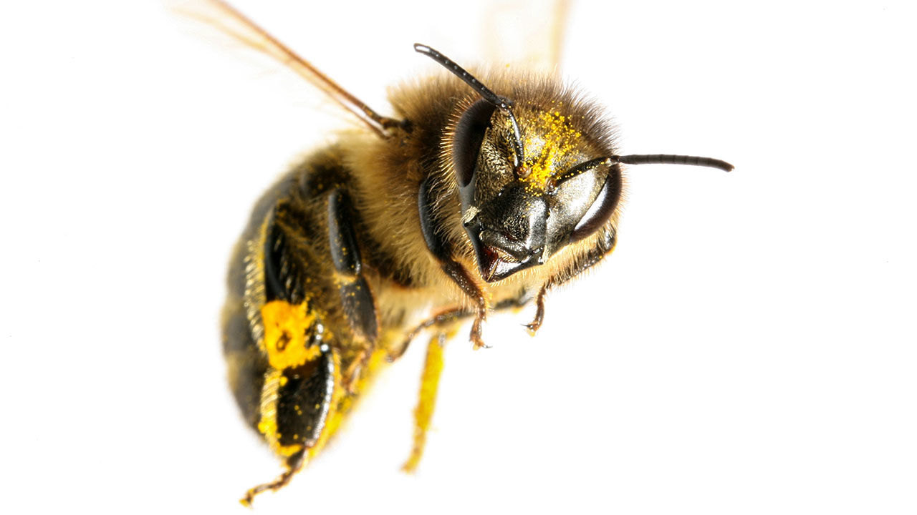
Learning Local Behavioral Sequences to Better Infer Non-local Properties in Real Multi-robot Systems
Taeyeong Choi, Sehyeok Kang, and Theodore P. Pavlic
Science and Engineering of Autonomous Decision-making Systems (SEADS) Lab

Slide 2
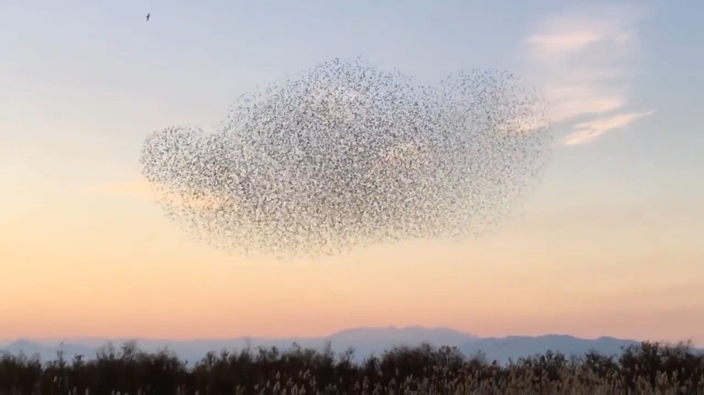
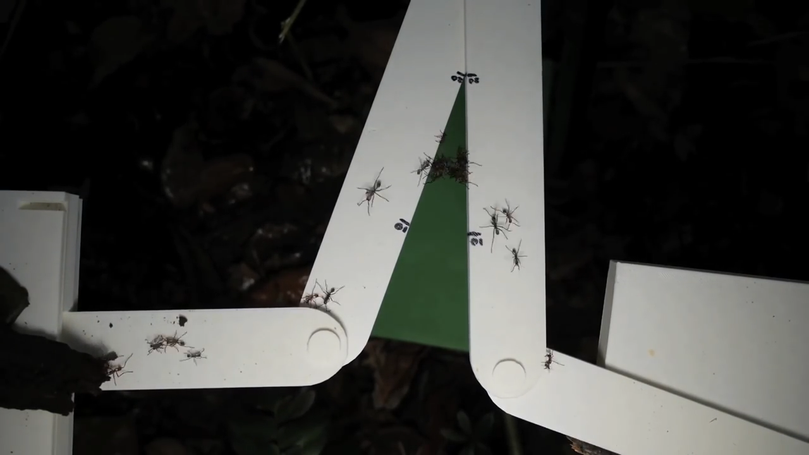
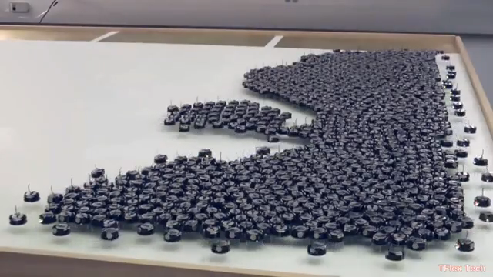

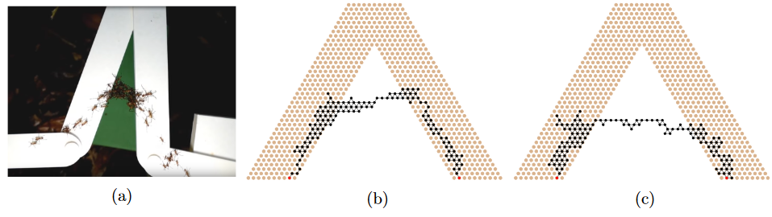
Local Rules to a Global Behavior
Global Situational Awareness from Local Cues
Rubenstein et al. (2014)
Arroyo et al. (2018)

Slide 3
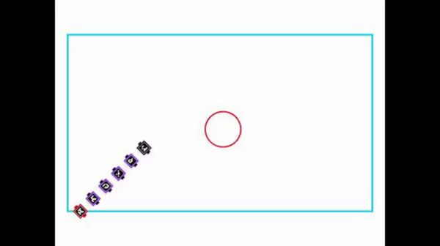
Caging Behavior with Global Situational Awareness
Choi et al. (2017)

Slide 4
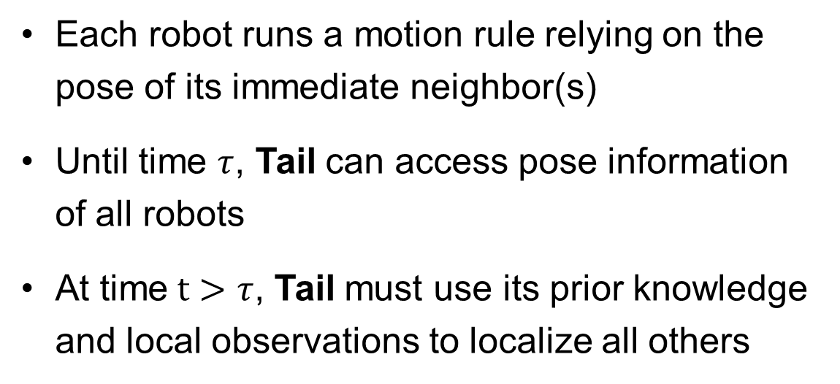
Remote Teammate Localization (ReTLo)
Each robot runs a motion rule relying on the pose of its immediate neighbor(s)
Until time $τ$, Tail can access pose information of all robots
At time $t>τ$, Tail must use its prior knowledge and local observations to localize all others
H
F3
Distant teammates to be localized
F2
Local observation of the nearest neighbor
F1
T

Slide 5
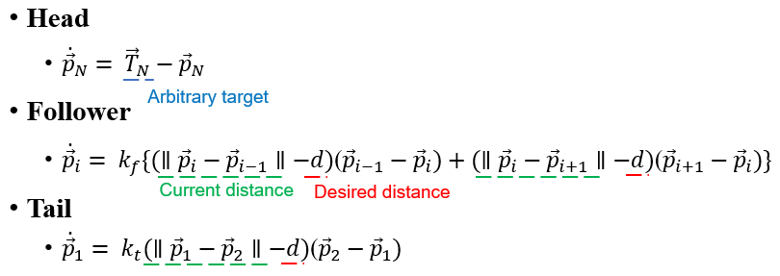
Previous Work (Choi et al. 2017)
H
H
F3
F3
F2
F2
F1
F1
T
T

Slide 6
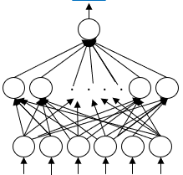
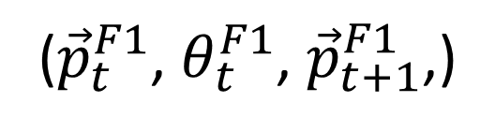
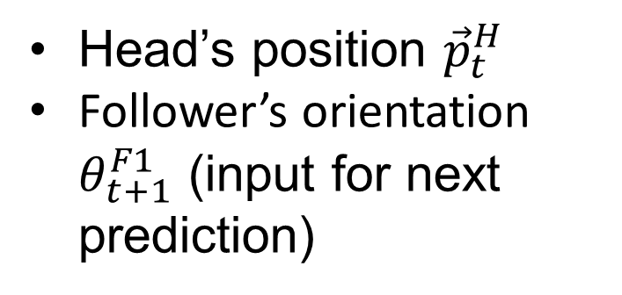
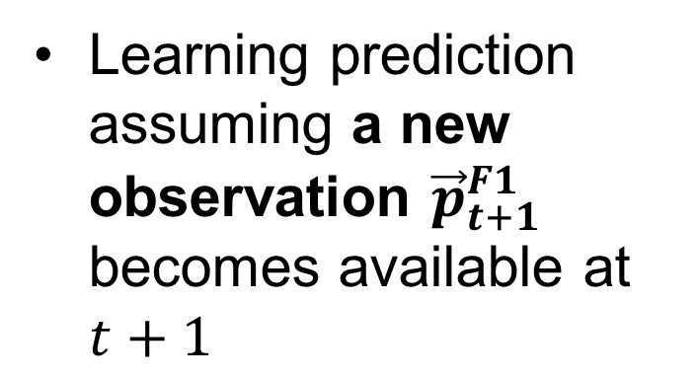
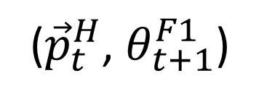
Previous Work (Choi et al. 2017)
Training in 3-robot team:
Learning prediction assuming a new observation ${\vec{p}}_{t+1}^{F1}$ becomes available at $t+1$
(${\vec{p}}_{t}^{H}$, $θ_{t+1}^{F1}$)
H
F1
Head’s position ${\vec{p}}_{t}^{H}$
Follower’s orientation $θ_{t+1}^{F1}$ (input for next prediction)
(${\vec{p}}_{t}^{F1}$, $θ_{t}^{F1}$, ${\vec{p}}_{t+1}^{F1}$,)
T
Newly observed

Slide 7
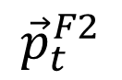
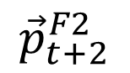
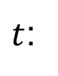
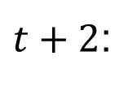
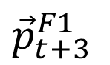
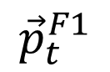
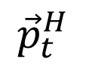
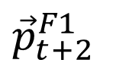
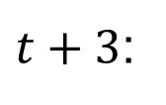
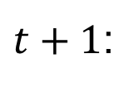
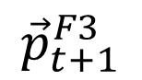

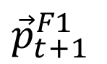
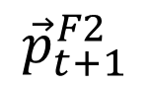
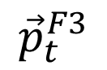
Previous Work (Choi et al. 2017)
Iterative application in 5-robot team:
Obs
Obs
Obs
Pred
Pred
Pred
H
$${\vec{p}}_{t}^{F1}$$
$t$:
F3
$${\vec{p}}_{t}^{F2}$$
$t+1$:
${\vec{p}}_{t+1}^{F1}$
$${\vec{p}}_{t}^{F3}$$
F2
$${\vec{p}}_{t+1}^{F2}$$
$${\vec{p}}_{t}^{H}$$
$t+2$:
${\vec{p}}_{t+2}^{F1}$
$${\vec{p}}_{t+1}^{F3}$$
Subteam 3
$${\vec{p}}_{t+2}^{F2}$$
F1
${\vec{p}}_{t+3}^{F1}$
$t+3$:
Subteam 2
T
Subteam 1
* Orientations are omitted for clarity

Slide 8
Previous Work (Choi et al. 2017)
Scalable Iterative application in 5-robot team:
Obs
Obs
Obs
Pred
Pred
Pred
H
$${\vec{p}}_{t}^{F1}$$
$t$:
F3
$${\vec{p}}_{t}^{F2}$$
Still workable on Physical Robotic Platforms?
$t+1$:
${\vec{p}}_{t+1}^{F1}$
$${\vec{p}}_{t}^{F3}$$
F2
$${\vec{p}}_{t+1}^{F2}$$
$${\vec{p}}_{t}^{H}$$
$t+2$:
${\vec{p}}_{t+2}^{F1}$
$${\vec{p}}_{t+1}^{F3}$$
$${\vec{p}}_{t+2}^{F2}$$
F1
${\vec{p}}_{t+3}^{F1}$
$t+3$:
T
* Orientations are omitted for clarity

Slide 9
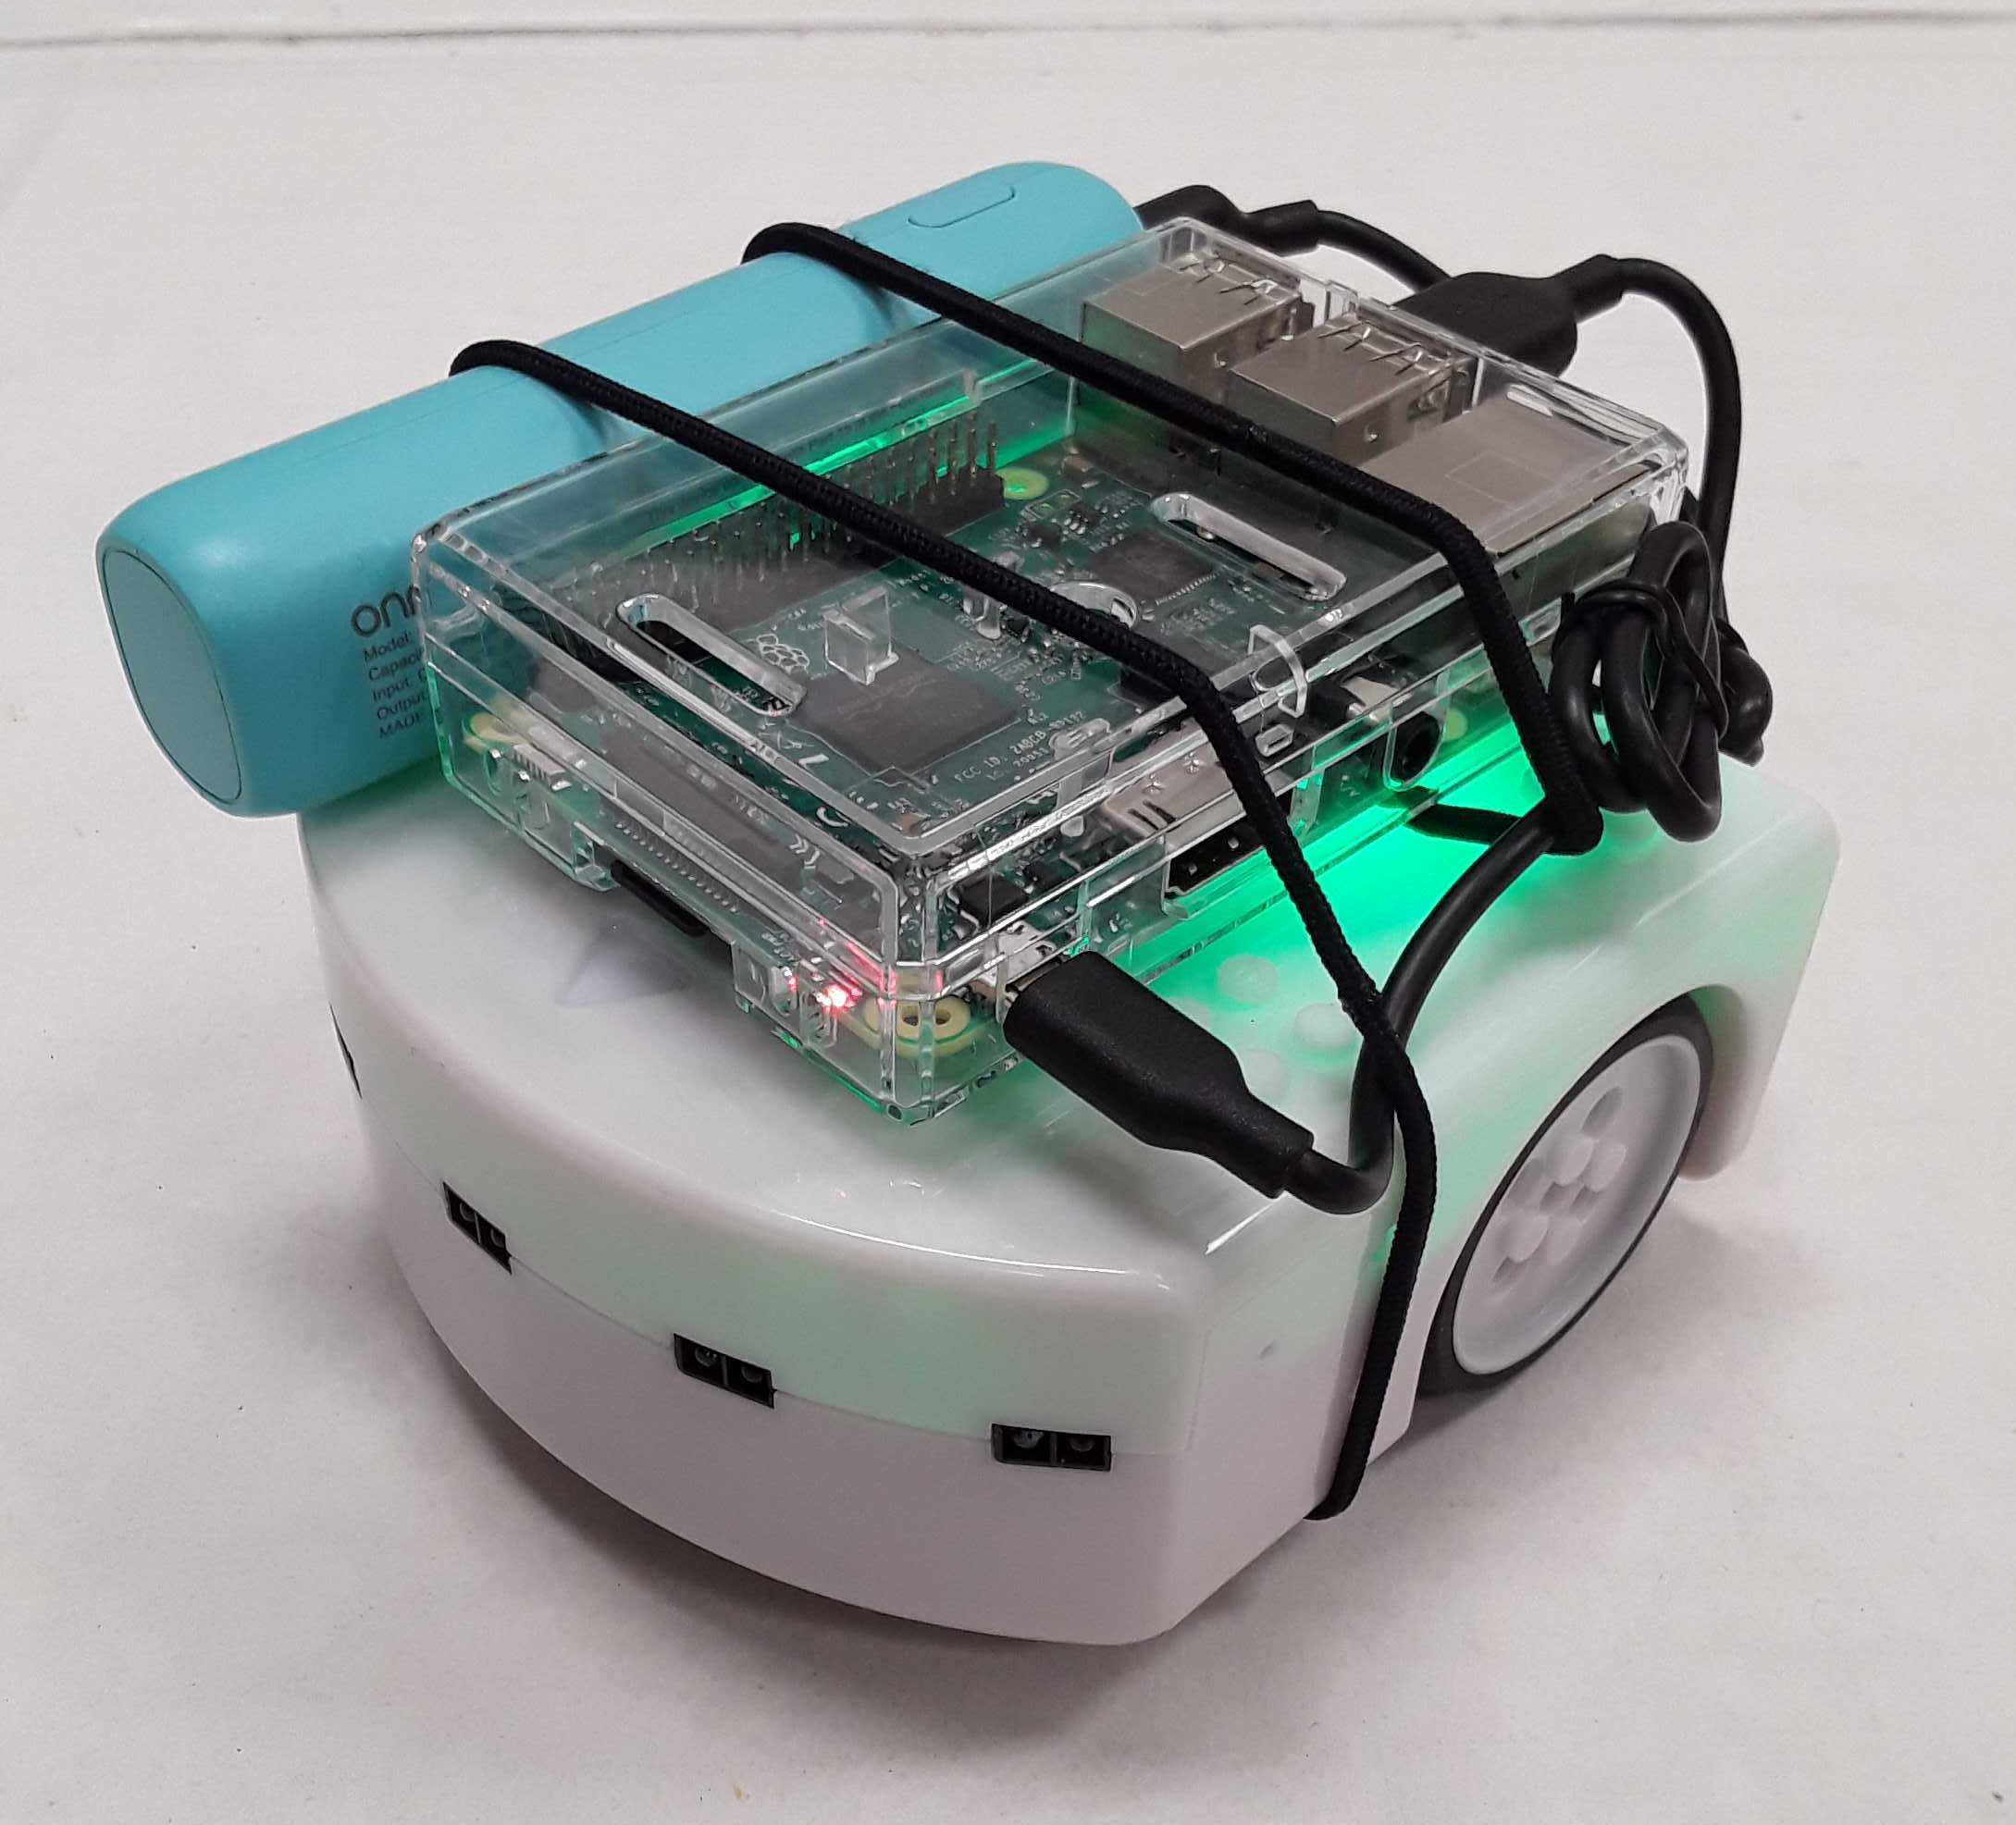

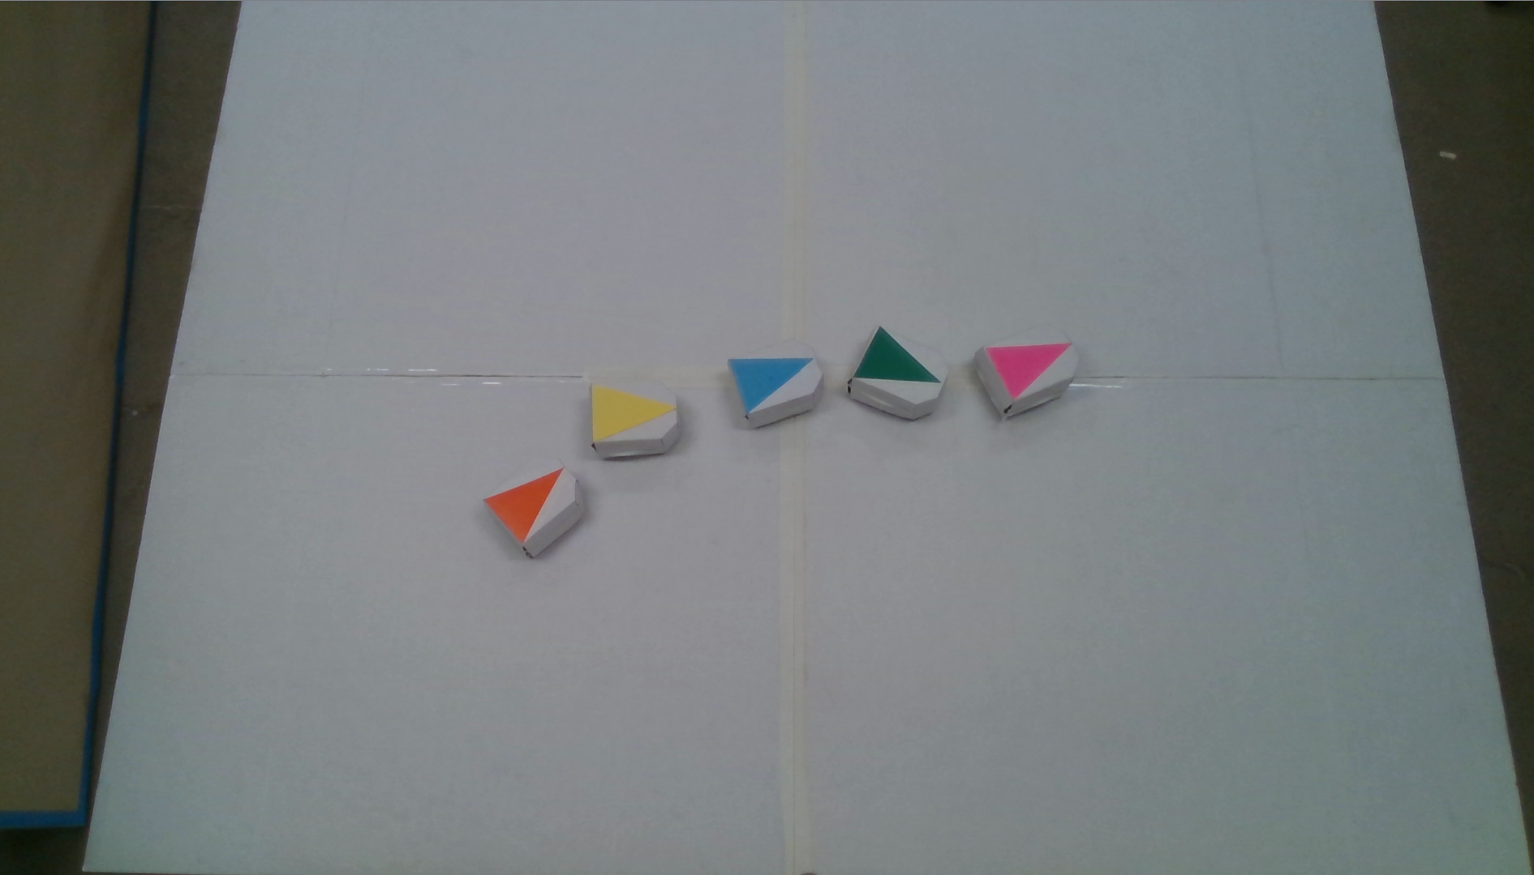


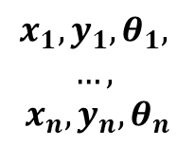
A commercially available, two-wheeled robotics platform, Thymio, equipped with Raspberry Pi
2.5 meters
$$x_{1},y_{1},θ_{1},$$
$$…,$$
$$x_{n}, y_{n}, θ_{n}$$
1.9 meters
A central computer with an overhead camera to simulate more generic proximity sensors and a virtual GPS system

Slide 10
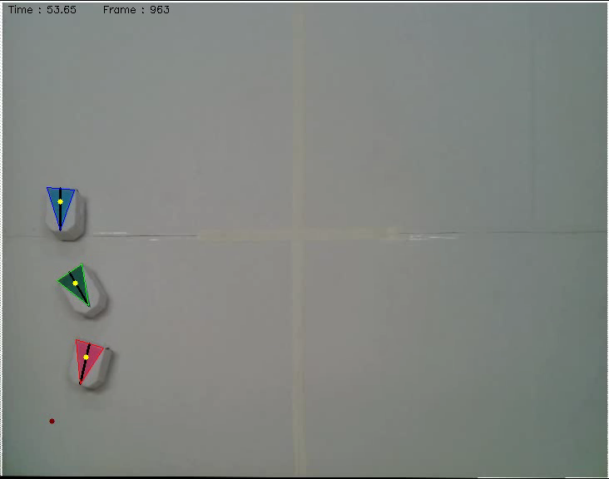
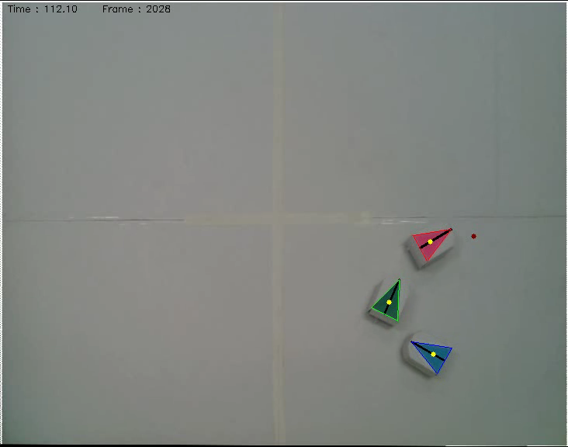
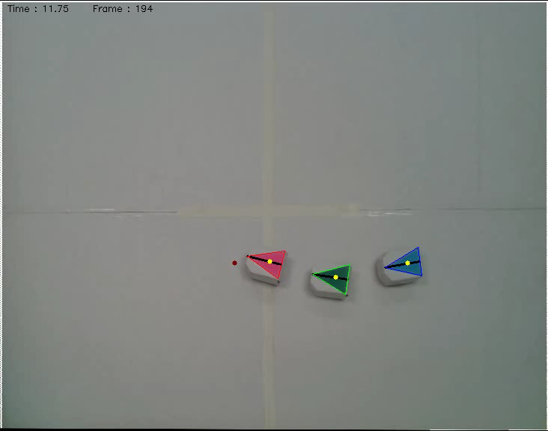
Data Collection:
Head moving toward random destinations
x,y-coordinates and orientations from each robot

Slide 11
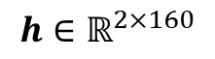
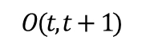
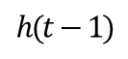
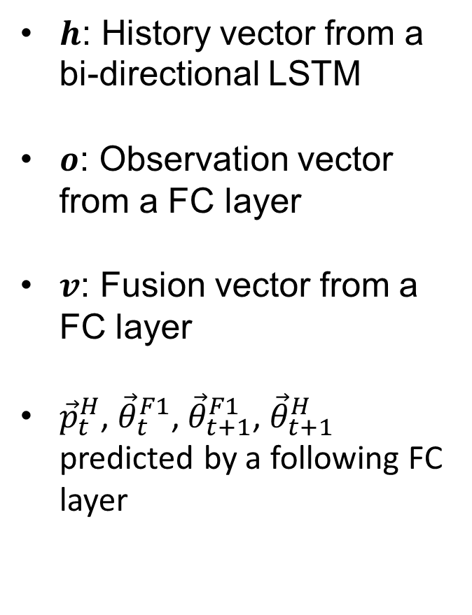
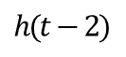
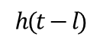
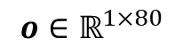
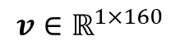
Learning Better with Historical Sequence
$h$: History vector from a bi-directional LSTM
$o$: Observation vector from a FC layer
$v$: Fusion vector from a FC layer
${\vec{p}}_{t}^{H}$, ${\vec{θ}}_{t}^{F1}$, ${\vec{θ}}_{t+1}^{F1}$, ${\vec{θ}}_{t+1}^{H}$ predicted by a following FC layer
Observation
Prediction
F1’
$${o∈ℝ}^{1×80}$$
$${v∈ℝ}^{1×160}$$
F1
…
H
T
$$O(t,t+1)$$
$${h∈ℝ}^{2×160}$$
. . .
Historical sequence
…
H
H
H
H
F1
F1
F1
F1
T
T
T
$$h(t−l)$$
$$h(t−2)$$
$$h(t−1)$$
T

Slide 12
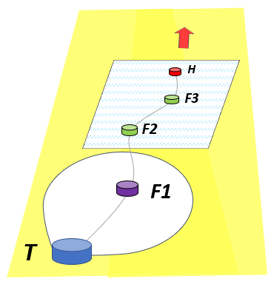
Experimental Details (1)
# of Robots | Total Duration | # of Samples | # of Instances
3 Robots | 100.6 minutes | 6,975 | 465
5 Robots | 45.0 minutes | 8,736 | 208
Recording rate: 2 samples / second
A sample: (10-step history, 2-step observation)
A data unit for a prediction execution
An instance: 16 sequential samples from the same trajectory
60% and 10% of 3-robot data for training and validation, respectively, and the rest of 3-robot and all of 5-robot data used for tests

Slide 13
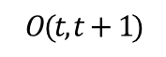

Experimental Details (2)
Baselines
2X Heuristic Algorithm
Doubling the vector toward the observed neighbor
H
$$\hat{H}$$
F1
T
FC Model
2-FC-layer-only model without history input, based on our previous work
Observation
Prediction
F1
F1’
…
H
T
$$O(t,t+1)$$

Slide 14
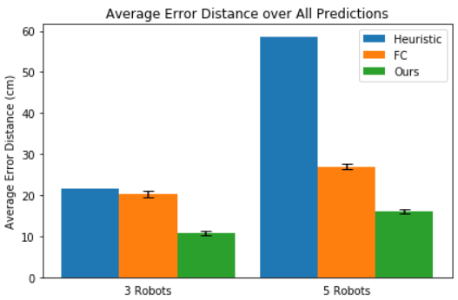
Quantitative Evaluations (1)
Average position estimation error per sample (Euclidean distance)
Learning based approaches all outperform the 2X Heuristic method
Ours reduces the errors of FC by 47% and 40% in the 3-robot and 5-robot case, respectively
History encoding helps definitely!
Body size of Thymio

Slide 15
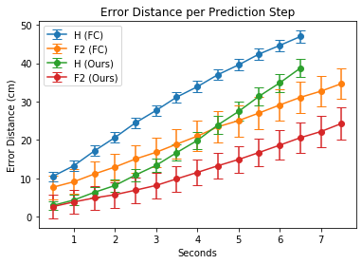
Quantitative Evaluations (2)
Step-wise prediction errors of FC and our method in the 5-robot team
Predictions for F3 omitted
More error accumulated for the further future steps and for farther robots due to the use of previous prediction as input
Always less error in ours for each robot; even our error for H lower than error for F2 of FC until 4 secs
Shaper error increase found as the LSTM layer is saturated more with previous predictions

Slide 16
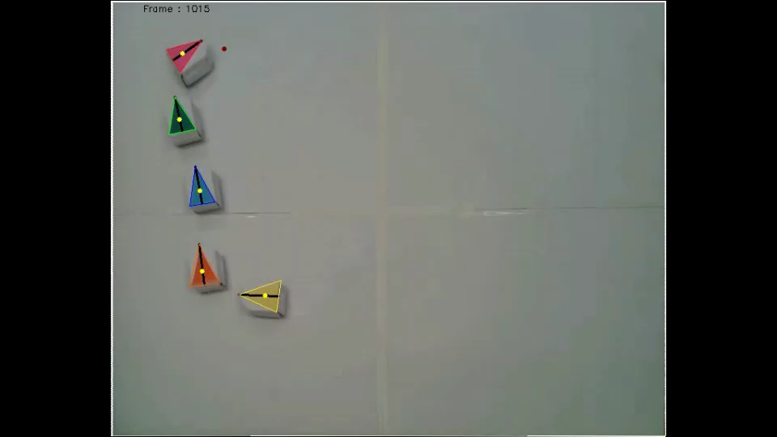
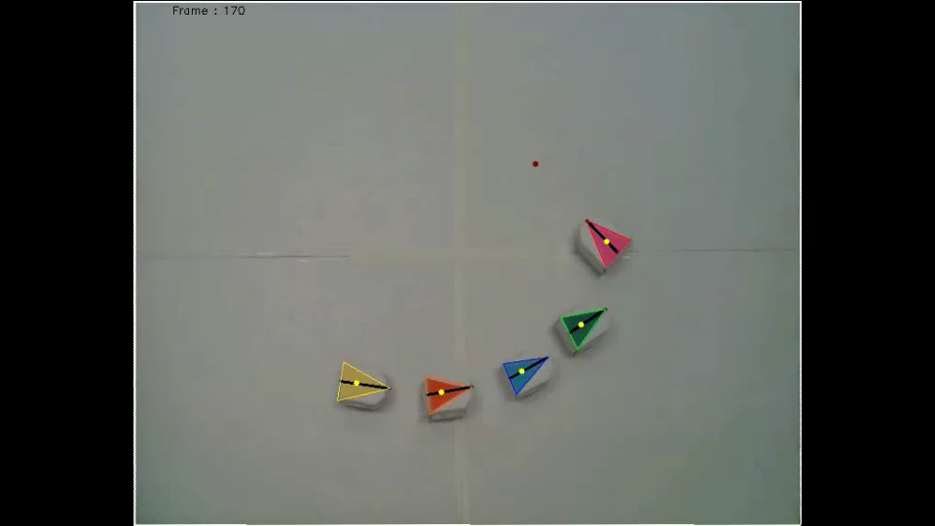
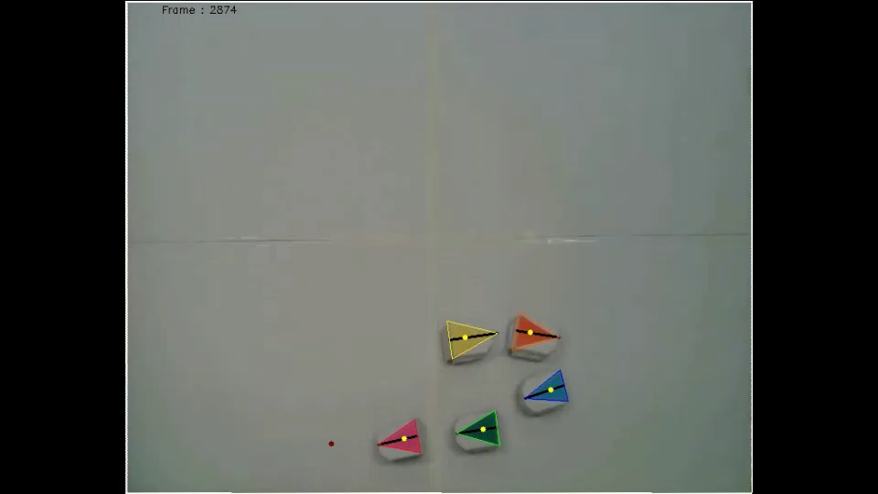
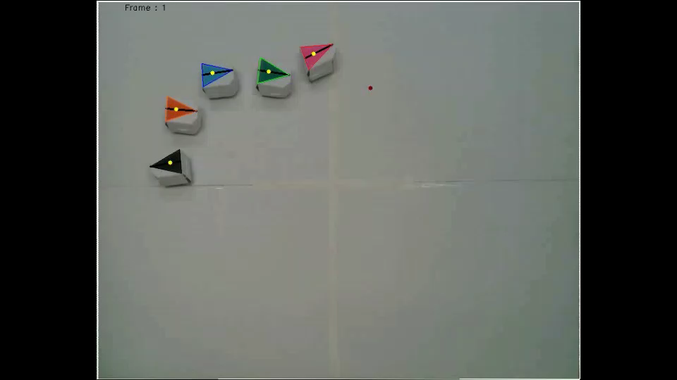
0.5X

Slide 17

Summarized Contributions
Showed the feasibility of Remote Teammate Localization (ReTLo) on real robotic teams, only using local observations of a single, nearest neighbor robot
Demonstrated through performance of our proposed method, the need of encoding historical trajectory information to significantly reduce estimation errors
Released collected data online to encourage more active research in this field

Slide 18



Science and Engineering of Autonomous Decision-making Systems (SEADS) Lab
Thanks!
Thanks!
Taeyeong Choi
Sehyeok Kang
Theodore P. Pavlic
* Dataset: https://github.com/ctyeong/ReTLo
Notes:
Sponsors?

